Slide 1
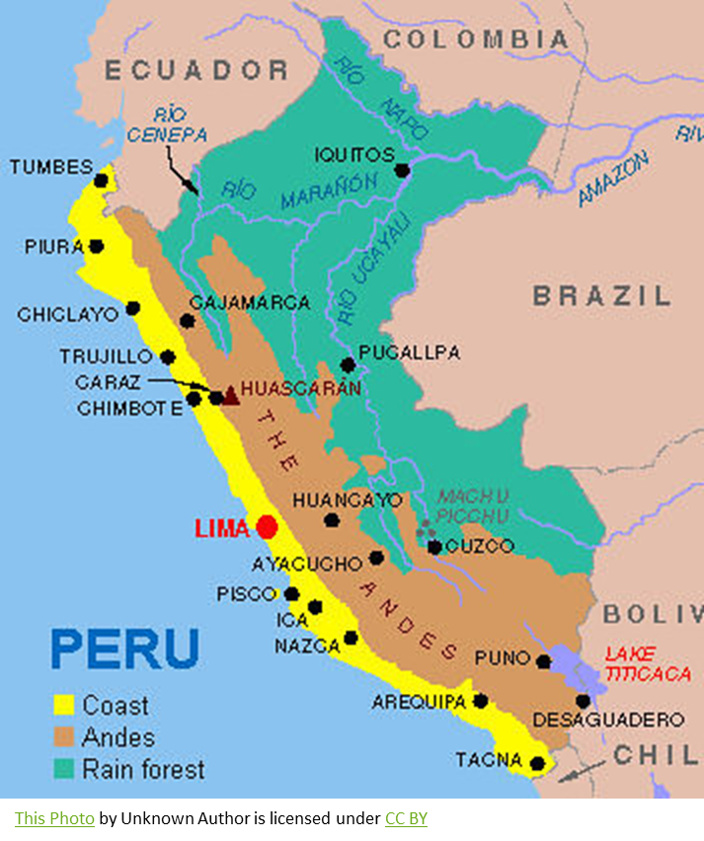
Peru
By Darragh hand AND A LITTLE HELP FROM MY DAD
27/04/2020

Slide 2
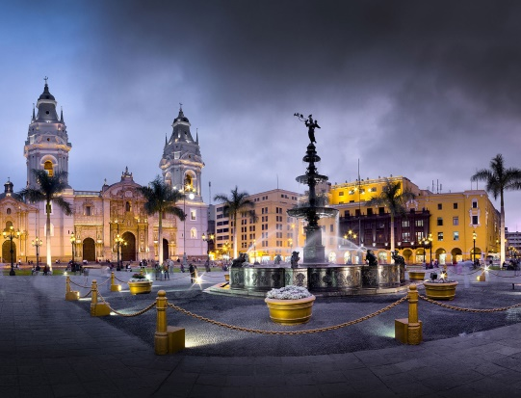
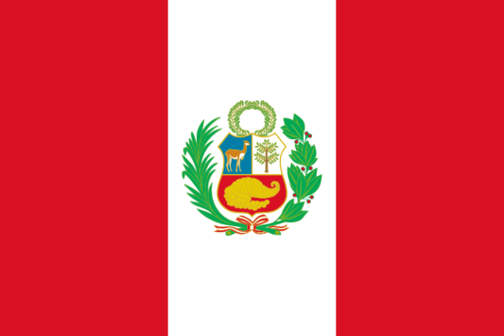
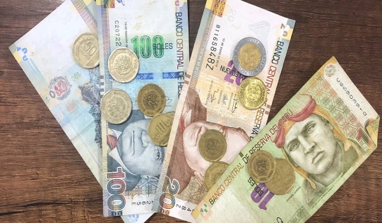
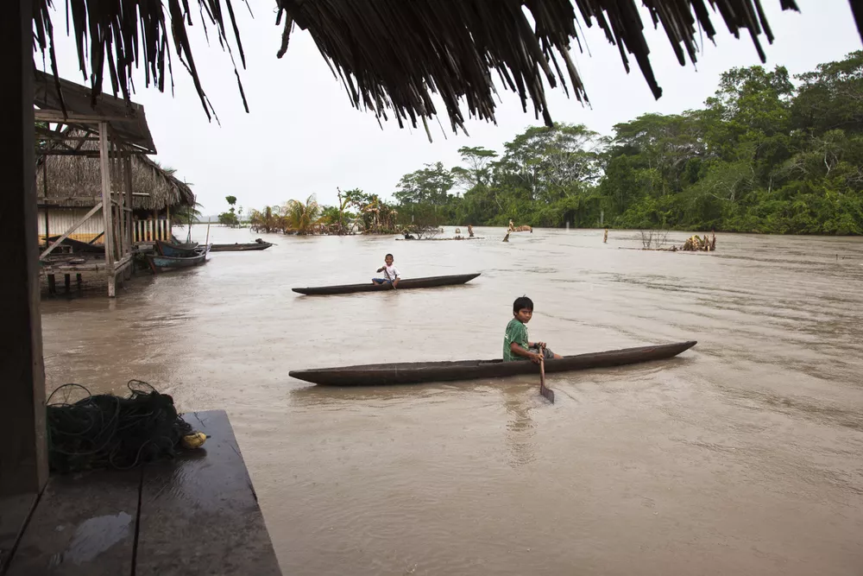
National flag of Peru is Map is showing the western South American country with a 2,414 km long coastline at the South Pacific Ocean. Peru is bordered by Bolivia, Brazil, Chile, Colombia, and Ecuador.
The Capital City Of Peru Is Lima and has a population of 32,971,854
The currency of Peru is called the Sol
At a length of 1,100 miles (1,771 km), the Ucayali River (Río Ucayali) is the longest river in Peru and a major tributary of the Amazon. The Ucayali begins in the Ucayali Region of Peru,
1. Huascarán
22,132 feet (6,746 m), Cordillera Blanca
Taking the title of the highest peak in the entire country is Huascarán. It is the southern most peak of the Cordillera Blanca mountain range, standing at 22,132 feet (6,746 m) tall. The mountain lies within Huascarán National Park,
By Darragh hand

Slide 3
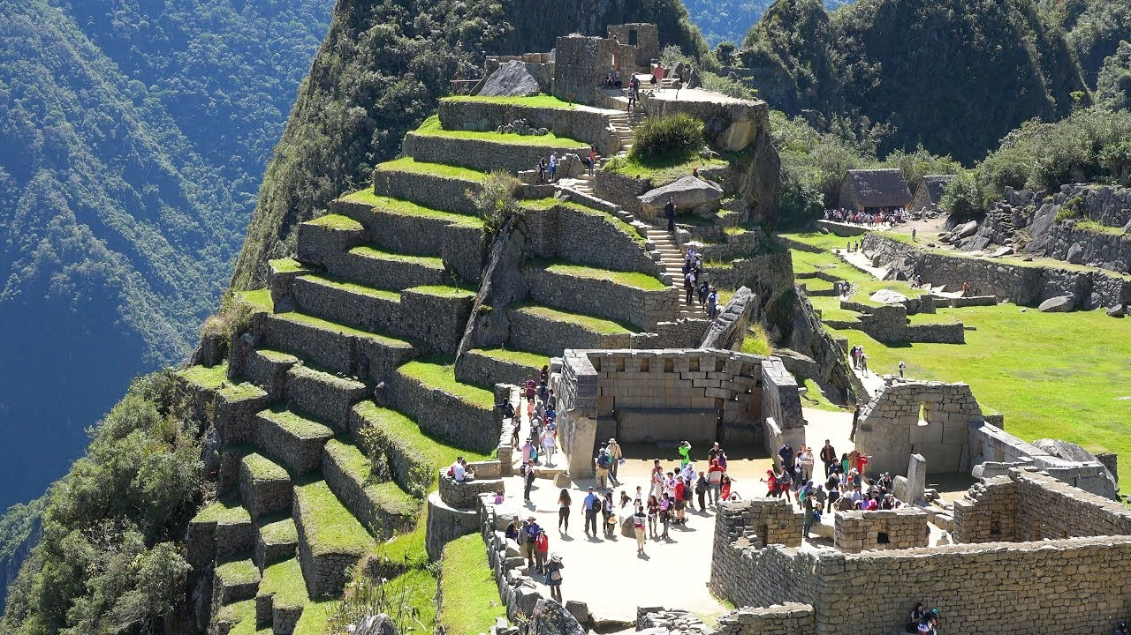
HISTORY Peru is a very old country. The earliest inhabitants arrived there about 15,000 years ago. Societies emerged on the west coast more than 5,000 years ago and began to spread inland. These included the Chavín, the Moche, and the Nasca. One of the most important Peruvian cultures was the Inca, who lived in Peru around 600 years ago. Their capital, Cusco, is still a major city today. The Inca also built Machu Picchu, a famous and mysterious ancient city in the Andes. They thrived for centuries before being conquered by the Spanish in 1532. PEOPLE & CULTURE The people of Peru are a mix of many different cultures, including Indians, Spaniards and other Europeans, descendants of African slaves, and Asians. Until recently, most people lived in the countryside. But now, more than 70 percent live in cities. Most Peruvians follow the Catholic religion introduced by the Spanish.
By Darragh hand

Slide 4
Peru Weather.
The only thing predictable about Peru's weather is its unpredictability. In fact, it's not uncommon to experience all four seasons in a single day. Generally speaking, Peru has two seasons, wet and dry, but in a country as geographically diverse as Peru, local weather patterns vary greatly.
Climate and Average Weather in Peru
Because Peru has such a diverse geography the weather can be varied per region. If it's warm on the coast it can be very cold in the mountains and you can find completely different weather in the jungle. On the coast winter lasts from June to September. During this period, the mountainous areas are often sunny and warm during the day but cold at night. This is tourist season and the best time to visit most regions. Heavy rains in the mountains and jungle last from December to April. It hardly ever rains in Lima and most of the coast. However there are some places, like Tumbes and Piura, which have tropical climates.
By Darragh hand

Slide 5
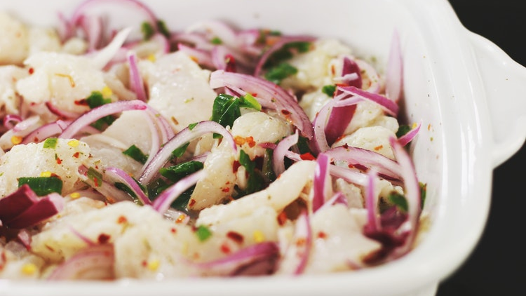
TRADITIONAL FOODS YOU NEED TO TRY IN PERU
Ceviche
Ceviche is probably Peru’s most famous food. When people think of Peruvian food, their minds will almost automatically go to Ceviche.
Ceviche consists of raw fish marinated in lime juice, chilies, and onions. It is one of Peru’s most beloved foods.
Lima is a coastal city. Therefore, it arguably has the best Ceviche is Peru. It is best enjoyed with sweet potatoes and corn.
It’s deliciously tangy and refreshing, and a must-eat for anyone visiting Peru.

Slide 6
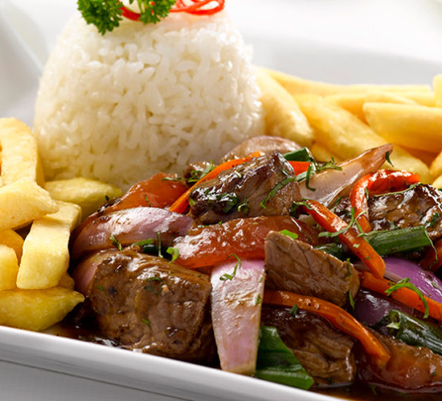
Lomo Saltado
Lomo Saltado’s origins are firmly in ‘Chifa’ cuisine. Chifa cuisine is extremely popular in Peru.
It is a blend of Chinese and Peruvian food. Its origins can be traced back to the influx of Chinese immigration to Peru in the late 19th century and early 20th century.
Lomo Saltado is now a staple in Peru’s mainstream cuisine. It is made with beef sirloin strips marinated in soy sauce, vinegar and spices, which are then stir-fried with tomatoes and onions. Then, it is served with the carb-combination of rice and potatoes, a nod to the Peruvian and Chinese mish-mash.
This hearty dish is a must for anyone visiting Peru. It is perfect after a long day of trekking!

Slide 7
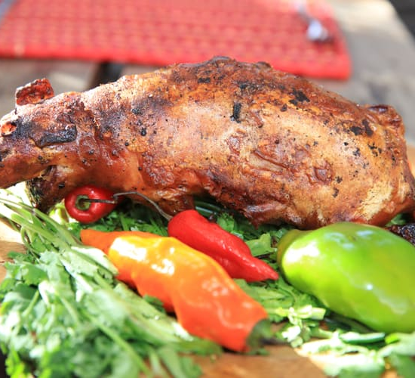
Cuy Cuy is known to English speakers as ‘Guinea Pig’. This dish is often misunderstood as a typical Peruvian food. In fact, it is only really eaten on special occasions by Peruvians. However, Cuy is very common in Cusco. This is because of its popularity with tourists who want to see if they can stomach it. Cuy is served whole and all of the guinea pig is supposed to be consumed. If you can look past its appearance, you’re rewarded with something quite delicious. Cuy tastes like good quality, lean pork. Close your eyes and enjoy this unique Peruvian food!

Slide 8
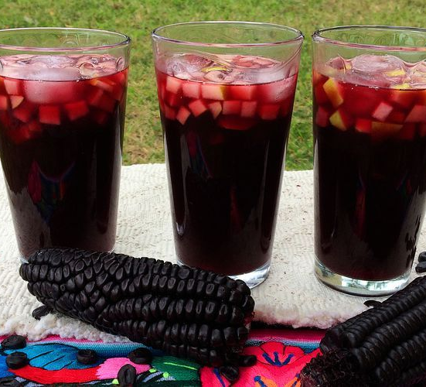
Chicha Morada
Another traditional Peruvian drink is the purple-colored Chicha Morada. It dates back to the Pre-Columbian era and was popular throughout the Andes. However, it’s now readily available throughout the country.
Chicha Morada’s main ingredient is purple corn. The preparation entails boiling purple corn in water with pineapple peel, quince and then adding cinnamon and cloves. It is strained and cooled, with sugar later added to the mix.
Chicha Morada is quite sweet. However, the purple corn is packed full of antioxidants and it’s said to reduce blood pressure. The drink is very popular in Peru. In fact, it sells as well as Coca-Cola.
No trip to Peru would be complete without sharing a Jarra of this over dinner.

Slide 9
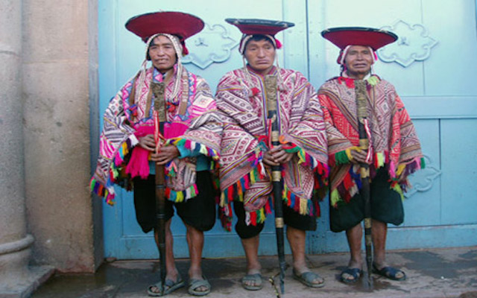
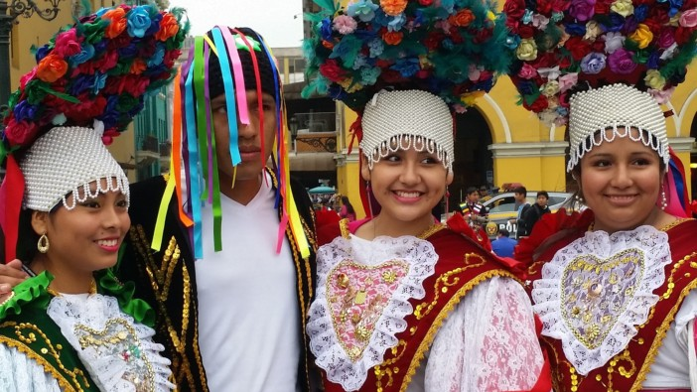
What Languages Are Spoken In Peru?
Spanish is the official language of Peru, and over 84% of the Peruvians speak this language. The government in Peru, the Peruvian educational system, and the media use Spanish as the principal means of communication. A large number of aboriginal languages are spoken in Peru, primarily by the native populations residing in the Amazon forests and the central Andes region. Some of these languages, however, have died out like the Mochica or are in the process of becoming extinct. Though nearly 300 to 700 aboriginal languages of Peru were spoken before the European invasion of the country, fewer than 150 are spoken today. Quechua and Aymara are two of the most spoken indigenous Peruvian languages.

Slide 10
What Is The Most Popular Pastimes In Peru?
Football
Peru’s major sport is football and you’ll find men and boys playing it in the streets of every city, town and settlement in the country down to the remotest of jungle outposts. The big teams are Cristal, Alianza and El U in Lima and Ciencianco from Cusco. The “Classic” game is between Alianza, the poor man’s team from the La Victoria suburb of Lima, and El U (“U” from “Universitario”), generally supported by the middle class. To get a flavour for just how popular football is in Peru try a visit to the Estadio Restaurant in Lima, which has great murals, classic team shirts and life-size models of the world’s top players.
Volleyball
Volleyball (vóley) is a very popular sport in Peru, particularly for women. The national team frequently reach World Cup and Olympic finals, and they are followed avidly on TV. Even in remote villages, most schools have girls’ volleyball teams. For more information, check out vivevoley.com.
Bullfighting
Although bullfighting is under threat from the pro-animal lobby, and has diminished significantly in popularity in the twenty-first century, in many coastal and mountain haciendas (estates), bullfights are still often held at fiesta times. In a less organized way they happen at many of the village fiestas, too – often with the bull being left to run through the village until it’s eventually caught and mutilated by one of the men. This is not just a sad sight, it can also be dangerous for unsuspecting tourists who happen to wander into a seemingly evacuated village. The Lima bullfights in October (see Fun with fountains), in contrast, are a very serious business; even Hemingway was impressed.

Slide 11
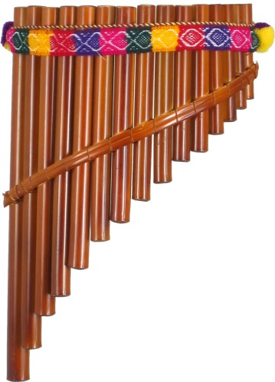
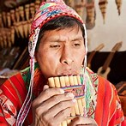
TRADITIONAL MUSIC IN PERU
TRADITIONAL MUSIC (Panpipes)
When we talk about the traditional types of music in Peru, defining panpipes is inevitable because panpipes are integral parts of Peruvian traditional music. Even though modern panpipes are played by group of performers with more than two performers, traditional panpipe performance strictly had only two performers.
Panpipes are made in such a way that each contains an alternative note that is in full scale and the pipes share the melody. Due to this characteristic feature of alternate notes, two performers are required to complete a full tune and this is done using the hocket technique. This can be interpreted as the symbolic representation of the reciprocity that is present in the Peruvian community and apart from the symbolism; this method helps the performers to stay away from the problem of dizziness caused by continuous breathing.

Slide 12
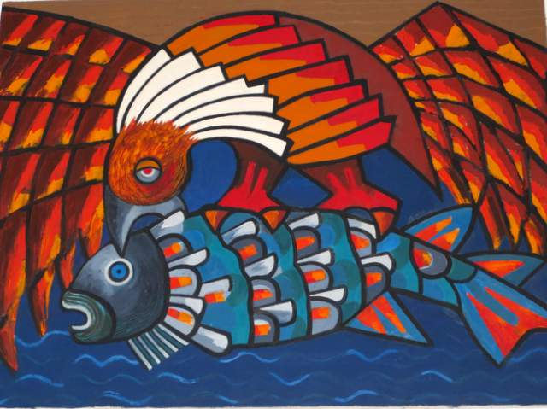
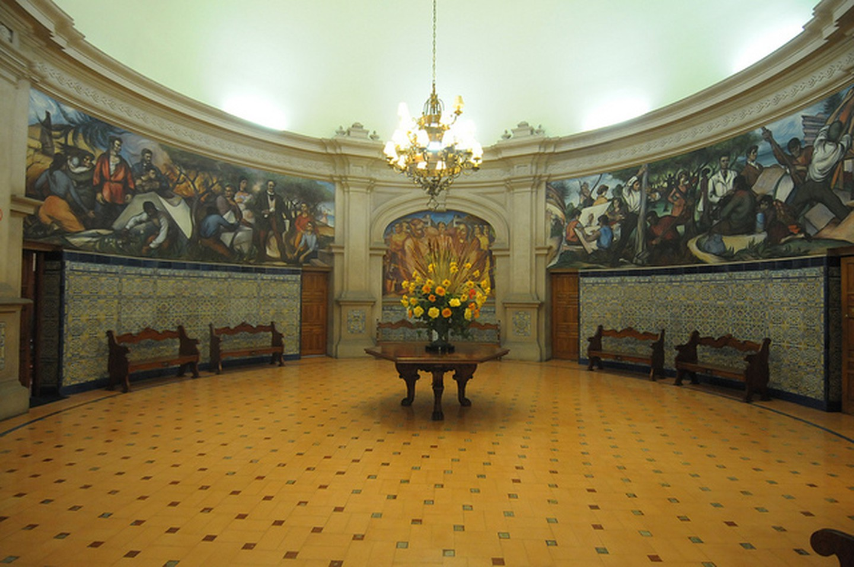
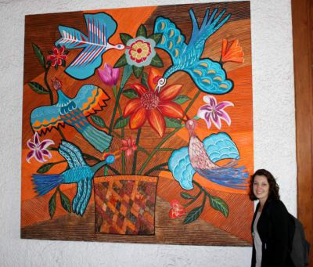
FAMOUS ARTISTS IN PERU
Teodoro Núñez Ureta
Ureta was a Peruvian painter and writer, noted for his originality. The subjects of his work focused on the Andes and its people, a topic that other painters had not prioritised in their work. He is undoubtedly the most important Peruvian muralist in the world and became the director of the National School of Fine Arts in Lima. His work expresses an emotional struggle for social justice in an unjust world.

Slide 13
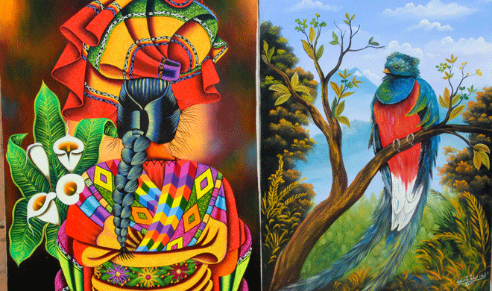
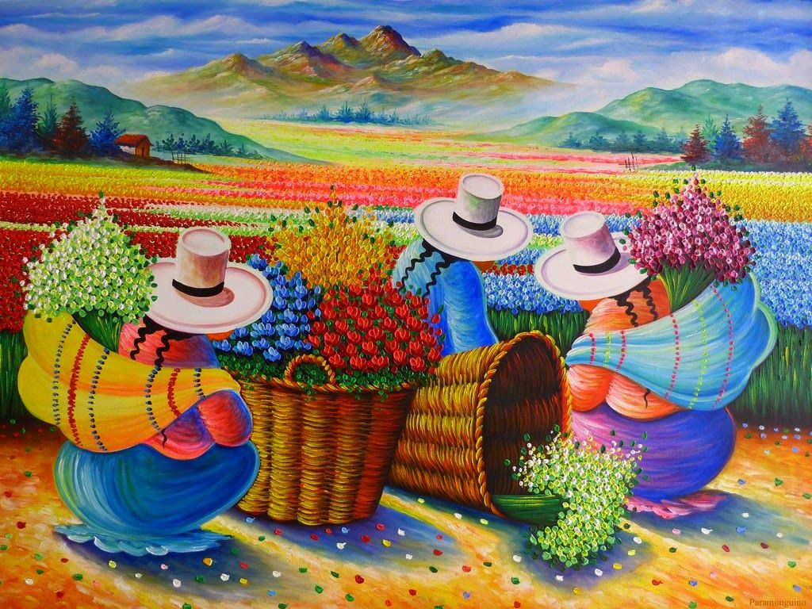
Grimanesa Amorós Grimanesa Amorós, born in Lima, Peru, is an artist well-known for large scale light sculpture installations. Her work incorporates elements from sculpture, video, lighting, and technology to create eye-catching and progressive art forms.
FAMOUS ARTISTS IN PERU

Slide 14
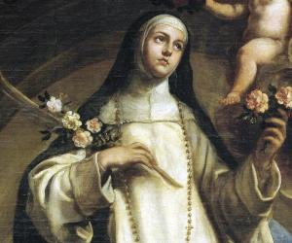
Rose of Lima20 April 1586
Saint

Slide 15
Beto da Silva28 December 1996
Footballer

Slide 16
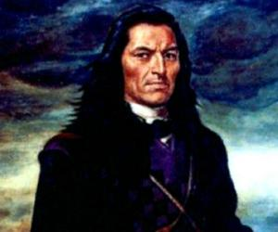
Túpac Amaru II10 March 1738
politician

Slide 17
And To Finish It Off…
Can You Name ONE MORE FAMOUS PERSON IN PERU
The One And Only…….

Slide 18
PADDINGTON BEAR
I hope you enjoyed my project on Peru.
As much as me and my dad did doing it ☺

